Slide 1
English For
Computer Science
Chapter 10 Computer and Network Security

Slide 2
What we need to know:
1. Principle of easiest penetration.
2. The kinds of computer security breaches.
3. What is firewall.
4. Steganography and digital forensics.
计算机专业英语
1-<number>

Slide 3
10.1 Characteristics of Computer Intrusion and Kinds of Security Breaches
New Words & Expressions:
breach 破坏，缺口 involve 包含，涉及，也可不译
depositor 寄托者 vulnerability 弱点，攻击
perimeter 周围，周边 penetrate vt. 渗入; 穿透
exposure 曝光，揭露 threat n. 威胁，恐吓
asset 资产 interruption 中断，打断
interception 截取 modification 修改
fabricate v. 伪造 tamper v. 篡改，影响
spurious adj. 假的
计算机专业英语
1-<number>

Slide 4
10.1 Characteristics of Computer Intrusion and Kinds of Security Breaches
10.1.1 入侵计算机的特点
Principle of Easiest Penetration.
An intruder must be expected to use any available means of penetration.
This will not necessarily be the most obvious means, nor will it necessarily be the one against which the most solid defense has been installed.
最容易攻破原理。入侵者必定要使用一种可以攻破的方法，这种方法既不可能是最常用的，也不可能是针对已经采取了最可靠的防范措施的方法。
计算机专业英语
1-<number>

Slide 5
10.1 Characteristics of Computer Intrusion and Kinds of Security Breaches
10.1.1 入侵计算机的特点
This principle says that computer security specialists must consider all possible means of penetration, because strengthening one may just make another means more appealing to intruders.
We now consider what these means of penetration are.
这一原理说明计算机安全专家必须考虑所有可能的攻击方法。由于你加强了某一方面，入侵者可能会想出另外的对付方法。
我们现在就说明这些攻击的方法是什么。
计算机专业英语
1-<number>

Slide 6
10.1 Characteristics of Computer Intrusion and Kinds of Security Breaches
10.1.2 KINDS OF SECURITY BREACHES
In security, an exposure is a form of possible loss or harm in a computing system;
examples of exposures are unauthorized disclosure of data, modification of data, or denial of legitimate access to computing.
A vulnerability is a weakness in the security system that might be exploited to cause loss or harm.
在计算机系统中，暴露是一种使安全完全丧失或受到伤害的一种形式；暴露的例子是非授权的数据公开、数据修改或拒绝合法的访问计算机。
脆弱性是安全系统中的薄弱环节，它可能引起安全的丧失或伤害。
计算机专业英语
1-<number>

Slide 7
10.1 Characteristics of Computer Intrusion and Kinds of Security Breaches
10.1.2 KINDS OF SECURITY BREACHES
A human who exploits a vulnerability perpetrates an attack on the system.
Threats to computing systems are circumstances that have the potential to cause loss or harm; human attacks are examples of threats, as are natural disasters, inadvertent human errors, and internal hardware or software flaws.
人可利用脆弱性对系统进行犯罪攻击。
对计算机系统的威胁是引起安全丧失或伤害的环境；人们的攻击是威胁的例子，如自然灾害，人们非故意错误和硬件或软件缺陷等。
犯(罪),做(坏事)
非故意
计算机专业英语
1-<number>

Slide 8
10.1 Characteristics of Computer Intrusion and Kinds of Security Breaches
10.1.2 KINDS OF SECURITY BREACHES
Finally, a control is a protective measure-an action, a device, a procedure, or a technique-that reduces a vulnerability.
最后，控制是一种保护性措施——控制可以是一种动作，一个设备，一个过程或一种技术——减少了脆弱性。
计算机专业英语
1-<number>

Slide 9
10.1 Characteristics of Computer Intrusion and Kinds of Security Breaches
10.1.2 KINDS OF SECURITY BREACHES
The major assets of computing systems are hardware, software, and data.
There are four kinds of threats to the security of a computing system: interruption, interception, modification, and fabrication.
The four threats all exploit vulnerabilities of the assets in computing systems. These four threats are shown in Fig.10-1.
计算机系统的主要资源是硬件、软件和数据。有四种对计算机安全的威胁：中断，截取，篡改和伪造。
这四种威胁都利用了计算机系统资源的脆弱性，图10-1表示这四种威胁。
计算机专业英语
1-<number>

Slide 10
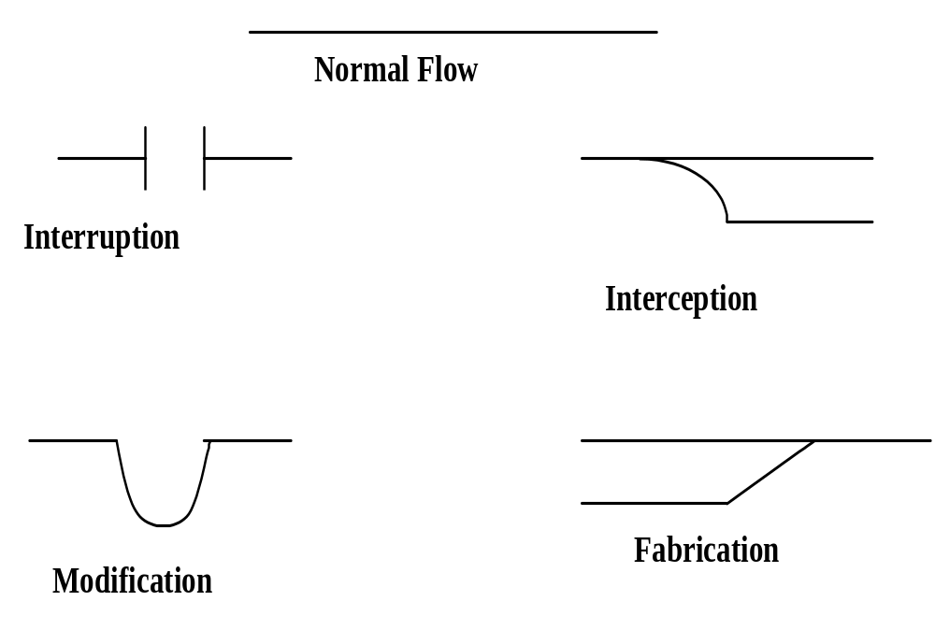
Fig.10-1 Four classes of System Security Failures
计算机专业英语
1-<number>

Slide 11
10.1 Characteristics of Computer Intrusion and Kinds of Security Breaches
10.1.2 KINDS OF SECURITY BREACHES
In an interruption, an asset of the system becomes lost or unavailable or unusable.
An example is malicious destruction of a hardware device, erasure of a program or data file, or failure of an operating system file manager so that it cannot find a particular disk file.
(1)在中断情况下，系统资源开始丢失，不可用或不能用。
例如，蓄意破坏硬件设备，抹除程序或数据文件或造成操作系统的文件管理程序故障，以致不能找到某一磁盘文件。
计算机专业英语
1-<number>

Slide 12
10.1 Characteristics of Computer Intrusion and Kinds of Security Breaches
10.1.2 KINDS OF SECURITY BREACHES
(2) An interception means that some unauthorized party has gained access to an asset.
The outside party can be a person, a program, or a computing system.
(2)截取是指某一非特许用户掌握了访问资源的权利。
外界用户可以是一个人、一个程序或一个计算机系统。
计算机专业英语
1-<number>

Slide 13
10.1 Characteristics of Computer Intrusion and Kinds of Security Breaches
10.1.2 KINDS OF SECURITY BREACHES
Examples of this type of failure are illicit copying of program or data files, or wiretapping to obtain data in a network.
While a loss may be discovered fairly quickly, a silent interceptor may leave no traces by which the interception can be readily detected.
这种威胁的例子如程序或数据文件的非法拷贝，或私自接线(窃听)入网去获取数据。
数据丢失可能会很快被发现，但很可能截取者并不留下任何容易检测的痕迹。
计算机专业英语
1-<number>

Slide 14
10.1 Characteristics of Computer Intrusion and Kinds of Security Breaches
10.1.2 KINDS OF SECURITY BREACHES
(3) If an unauthorized party not only accesses but tampers with an asset, the failure becomes a modification.
For example, someone might modify the values in a database, alter a program so that it performs an additional computation, or modify data being transmitted electronically.
(3)如果非授权用户不仅可以访问计算机资源，而且可以篡改资源，则威胁就成为修改了。
例如，某人可以修改数据库中的值，更换一个程序，以便完成另外的计算，或修改正在传送的数据。
计算机专业英语
1-<number>

Slide 15
10.1 Characteristics of Computer Intrusion and Kinds of Security Breaches
10.1.2 KINDS OF SECURITY BREACHES
It is even possible for hardware to be modified.
Some cases of modification can be detected with simple measures, while other more subtle changes may be almost impossible to detect .
甚至还可能修改硬件。
某些情况下可以用简单的测量手段检测出所做的修改，但某些微妙的修改是不可能检测出来的。
计算机专业英语
1-<number>

Slide 16
10.1 Characteristics of Computer Intrusion and Kinds of Security Breaches
10.1.2 KINDS OF SECURITY BREACHES
(4) Finally, an unauthorized party might fabricate counterfeit objects for a computing system.
The intruder may wish to add spurious transactions to a network communication system, or add records to an existing database.
(4)最后，非授权用户可以伪造计算机系统的一些虚假的对象。
入侵者妄图向网络通信系统加入一个假的事务处理业务，或向现有的数据库加入记录。
计算机专业英语
1-<number>

Slide 17
10.1 Characteristics of Computer Intrusion and Kinds of Security Breaches
10.1.2 KINDS OF SECURITY BREACHES
Sometimes these additions can be detected as forgeries, but if skillfully done, they are virtually indistinguishable from the real thing.
有时，这些增加的数据可以作为伪造品检测出来，但如果做得很巧妙，这些数据实际上无法与真正的数据分开。
计算机专业英语
1-<number>

Slide 18
10.1 Characteristics of Computer Intrusion and Kinds of Security Breaches
10.1.2 KINDS OF SECURITY BREACHES
These four classes of interference with computer activity-interruption, interception, modification, and fabrication-can describe the kinds of exposures possible.
这四种对计算机工作的干扰——中断，截取，修改或伪造——表明了可能出现的几种威胁类型。
计算机专业英语
1-<number>

Slide 19
10.2 Modern Cryptography- Data Encryption
New Words & Expressions:
cryptography n. 密码学 encryption 加密
cipher n. 密码（钥），加密程序 decrypt v. 解密
transit 通行（过），运输 plaintext n. 明文
cyphertext n. 密文 scheme n. 计划，方案
secret-key 秘钥 public-key 公钥
symmetric adj. 对称的 data integrity 数据完整性
session key 会话密钥 crack v. 解开，裂开
hacker 黑客，计算机窃贼 encode v. 编码
triple-encryption 三重加密 built-in 内在(固有)的，
state-of-the-art 最新的 proliferate v. 增生,扩散
Abbreviations :
DES (Data Encryption System) 数据加密系统
DCE ( Distributed Computing Environment) 分布式计算环境
计算机专业英语
1-<number>

Slide 20
10.2 Modern Cryptography- Data Encryption
If the receiver of the encrypted data wants to read the original data, the receiver must convert it back to the original through a process called decryption.
Decryption is the inverse of the encryption process.
In order to perform the decryption, the receiver must be in possession of a special piece of data called the key.
如果接收到加密数据的人要看原来的数据，就必须把数据转换为原来的形式，这个过程称为解密。
解密是加密过程的逆过程。为了进行解密，接收者必须有称为密钥的特殊数据。
计算机专业英语
1-<number>

Slide 21
10.2 Modern Cryptography- Data Encryption
The two main competing cryptography schemes are known as the secret-key (symmetric) system and the public-key (asymmetric) system.
The secret-key system uses a single, wholly secret sequence both to encrypt and to decrypt messages.
The public-key system uses a pair of mathematically related sequences, one each for encryption and decryption.
现在有两种主要的、相互竞争的密码术：秘钥（对称）和公钥（不对称）系统。
秘钥系统采用单一的绝密序列，对报文进行加密和解密。
公钥系统采用一对数学上相关的序列，一个用于加密，另一个用于解密。
计算机专业英语
1-<number>

Slide 22
10.2 Modern Cryptography- Data Encryption
Secret-key encryption
One of the most popular secret-key encryption schemes is IBM’s Data Encryption System (DES), which became the U.S. federal standard in 1997.
The standard form uses a 56-bit key to encrypt 64-bit data blocks.
密钥加密
IBM的数据加密系统(DES)是最流行的密钥加密方案之一。1977年，该方案成为美国联邦标准。
该标准形式采用56位的密钥对64位的数据块进行加密。
计算机专业英语
1-<number>

Slide 23
10.2 Modern Cryptography- Data Encryption
The following is a notation for relating plaintext, ciphertext, and keys.
We will use C=E _{k} (P) to mean that the encryption of the plaintext P using key k gives the ciphertext C.
Similarly, P=D _{k} (C) represents of decryption of C to get the plaintext again. It then follows that D _{k} ( E _{k} (P))=P
下面是有关明文、密文和密钥关系的表示法。
我们用C=E _{k} (P)表示用密钥K对明文P加密，得到密文C。
类似的，P=D _{k} (C)代表对C解密得到明文。因而遵循：D _{k} (E _{k} (P))=P
计算机专业英语
1-<number>

Slide 24
10.2 Modern Cryptography- Data Encryption
To crack a DES-encrypted message a hacker or commercial spy would need to try 2⁵⁶ possible keys.
This type of search would need days of computer time on the world’s fastest supercomputers.
Even then, the message may not be cracked if the plaintext is not easily understood.
为了破解一个DES加密的报文，黑客或商业间谍需要试验2⁵⁶种可能的密钥，
这种搜索在世界上最快的巨型机上也需好几天的计算机时间。
如果未加密的“明文”是不易理解的，即使算出报文也可能解不开。
计算机专业英语
1-<number>

Slide 25
10.2 Modern Cryptography- Data Encryption
Developers using DES can improve security by changing the keys frequently, using temporary session keys, or using triple-encryption DES.
With triple DES, each 64-bit block is encrypted under three different DES keys.
Recent research has confirmed that triple-DES is indeed more secure than single-DES.
使用DES的开发人员可以通过频繁更改密钥，使用临时的会话密钥或使用三重加密DES来提高安全性。
使用三重DES时，每个64位数据块用三种不同的DES密钥加密。
最新研究已确认三重DES确实比单重DES更安全。
计算机专业英语
1-<number>

Slide 26
10.2 Modern Cryptography- Data Encryption
Public-key encryption
The key distribution problem has always been the weak link in the secret-key systems.
Since the encryption key and decryption key are the same( or easily derived from one another) and the key has to be distributed to all users of the system
公钥加密
密钥的分发问题在秘钥系统中一直是一个薄弱环节。
因为加密密钥和解密密钥是相同的（或彼此容易推出来）并且这个密钥必须分配给该秘钥系统的所有用户。
计算机专业英语
1-<number>

Slide 27
10.2 Modern Cryptography- Data Encryption
Public-key encryption
It seemed as if there was an inherent built-in problem:
keys had to be protected from theft, but they also had to be distributed, so they could not just be locked up in a bank vault.
公钥加密
这好像是存在一个固有的内部问题:
必须保护密钥不被偷窃，但又必须分布出去，所以它们不可能只是锁在银行的地下室里。
计算机专业英语
1-<number>

Slide 28
10.2 Modern Cryptography- Data Encryption
Encryption can be used to protect data in transit as well as data in storage.
Some vendors provide hardware encryption devices that can be used to encrypt and decrypt data.
There are also software encryption packages which are available either commercially or as free software.
加密可以用来保护传输中的数据和存储器中的数据。
一些厂家提供硬件加密设备，用来加密和解密数据。
也可买到软件加密程序包或作为自由软件免费获得。
计算机专业英语
1-<number>

Slide 29
10.2 Modern Cryptography- Data Encryption
Encryption can be defined as the process of tasking information that exists in some readable form (plaintext) and converting it into a form (ciphertext) so that it cannot be understood by others.
加密可以定义为把现有的、以某种可读形式（明文）的信息转换成其他人不能理解的形式（密文）的过程。
计算机专业英语
1-<number>

Slide 30
10.2 Modern Cryptography- Data Encryption
In public key cryptosystem, the encryption and decryption keys were different, and plaintext encrypted with the public key can only be deciphered with the private key from the same pair.
Conversely, plaintext encrypted with the private key can be decrypted only with the public key ( it is used in electronic signatures). The notations for these are as follows.
C=E _{k} (P) , P=D _{k1}(C)=D _{k1} (E _{k} (P)) or
C=D _{k1} (P), P=E _{k} (C)=E _{k} (D _{k1} (P))
在公钥秘钥系统中，加密和解密密钥是不同的。并且用公开密钥加密的明文只能用同一对密钥中的秘密密钥解密。
相反，用私有密钥加密的明文只能用公开密钥解密（它用于电子签名）。这些关系的表示法如下：(见上式）
计算机专业英语
1-<number>

Slide 31
10.2 Modern Cryptography- Data Encryption
Here k is a public key and k1 is private key (or secret key).
Users can make their public keys freely available or place them at a key distribution center for others to access.
However, the private key must be kept safe. In public-key systems there is no need to find a safe channel for communicating a shared secret key.
这里K是公开密钥，K1是私有密钥（或秘密密钥）。
用户可以让他们的公开密钥自由地使用，或把它们放在密钥分配中心供其他人存取。
然而，私有密钥必须安全的保存。在公开密钥系统，无需找一条传送共享的私有密钥的安全通道。
计算机专业英语
1-<number>

Slide 32
10.2 Modern Cryptography- Data Encryption
Public Key Infrastructure (PKI, 公钥基础设施)
In cryptography, a PKI is an arrangement that binds public keys with respective identities of entities (like persons and organizations).
The binding is established through a process of registration and issuance of certificates at and by a certificate authority (CA).
Depending on the assurance level of the binding, this may be carried out by an automated process or under human supervision.
在密码学里，公钥基础设施是一种把公钥和实体身份进行绑定的一种约定。
绑定是使用认证中心进行证书注册、发放的过程。基于绑定的确保等级，这个过程可以是一个自动的过程，也可以在人类监督下进行。
计算机专业英语
1-<number>

Slide 33
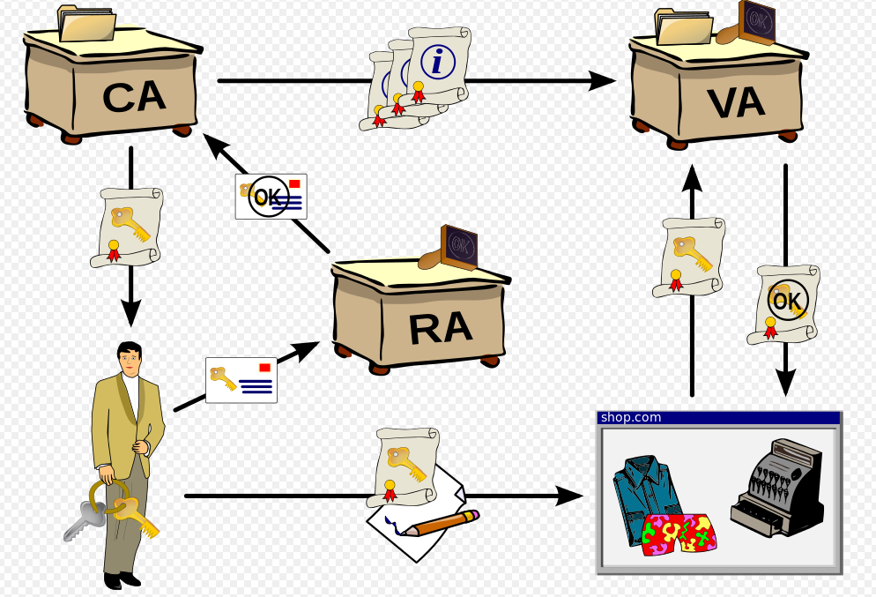
10.2 Modern Cryptography- Data Encryption
Public Key Infrastructure (PKI, 公钥基础设施)
A certificate authority (CA) that stores, issues and signs the digital certificates; 认证中心
A registration authority (RA) which verifies the identity of entities requesting their digital certificates to be stored at the CA. 注册中心
Certificates 证书 （ X.509格式）
计算机专业英语
1-<number>

Slide 34
10.2 Modern Cryptography- Data Encryption
Digital signature 数字签名
A digital signature is a mathematical scheme for verifying the authenticity (真实性) of digital messages or documents.
A valid digital signature, where the prerequisites (先决条件) are satisfied, gives a recipient very strong reason to believe that the message was created by a known sender (authentication), and that the message was not altered in transit (integrity).
计算机专业英语
1-<number>

Slide 35
10.2 Modern Cryptography- Data Encryption
Digital signature 数字签名
Digital signatures are a standard element of most cryptographic protocol suites, and are commonly used for software distribution, financial transactions, contract management software, and in other cases where it is important to detect forgery or tampering.
计算机专业英语
1-<number>

Slide 36
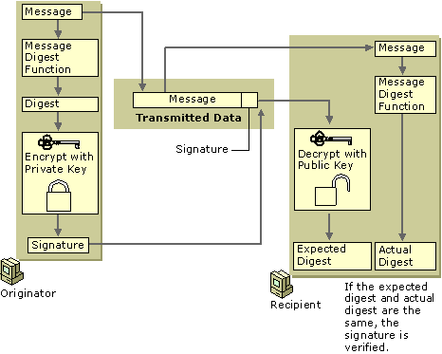
10.2 Modern Cryptography- Data Encryption
Digital signature 数字签名
计算机专业英语
1-<number>

Slide 37
10.2 Modern Cryptography- Data Encryption
confused challenge cracker security media
breaches proficient technical licenses weaknesses
The term hacker is used in popular (1)media to describe someone who attempts to break into computer systems. Typically, this kind of hacker would be a (2)proficient programmer or engineer with sufficient (3)technical knowledge to understand the weak points in a (4)security system.
A (5)cracker is someone who breaks into someone else's computer system, often on a network; bypasses passwords or (6)licenses in computer programs; or in other ways intentionally (7)breaches computer security.
计算机专业英语
1-<number>

Slide 38
10.2 Modern Cryptography- Data Encryption
confused challenge cracker security media
breaches proficient technical licenses weaknesses
A cracker can be doing this for profit, maliciously, for some altruistic purpose or cause, or because the (8)challenge is there. Some breaking-and-entering has been done ostensibly to point out (9)weaknesses in a site's security system.
The term "cracker" is not to be (10)confused with "hacker". Hackers generally deplore cracking. However, as Eric Raymond, compiler of The New Hacker's Dictionary notes, some journalists ascribe break-ins to "hackers."
计算机专业英语
1-<number>

Slide 39
10.2 Modern Cryptography- Data Encryption
confused challenge cracker security media
breaches proficient technical licenses weaknesses
The term hacker is used in popular (1)media to describe someone who attempts to break into computer systems. Typically, this kind of hacker would be a (2)proficient programmer or engineer with sufficient (3)technical knowledge to understand the weak points in a (4)security system.
A (5)cracker is someone who breaks into someone else's computer system, often on a network; bypasses passwords or (6)licenses in computer programs; or in other ways intentionally (7)breaches computer security.
计算机专业英语
1-<number>

Slide 40
10.2 Modern Cryptography- Data Encryption
confused challenge cracker security media
breaches proficient technical licenses weaknesses
A cracker can be doing this for profit, maliciously, for some altruistic purpose or cause, or because the (8)challenge is there. Some breaking-and-entering has been done ostensibly to point out (9)weaknesses in a site's security system.
The term "cracker" is not to be (10)confused with "hacker". Hackers generally deplore cracking. However, as Eric Raymond, compiler of The New Hacker's Dictionary notes, some journalists ascribe break-ins to "hackers."
计算机专业英语
1-<number>

Slide 41
10.3 How Firewalls Work
New Words & Expressions
firewall n. 防火墙 offensive adj. 无理的，攻击性的
hacker n. 黑客 filter v. 过滤，滤过，渗入
private 私有的，秘密地 packet n. 小包，信息包
employee n. 职员，雇工 telnet n. 远程登录
traffic n. 流量 proxy n. 代理
retrieve v, 检索 match n.比较，匹配，符合
customizable 可定制的 block n. 妨碍，阻碍
port n. 端口 bug n. 故障，（程序）错误
unsolicited adj.主动提供的 junk n.垃圾，无用数据
spam n. 垃圾邮件 counter v. 还击，驳回
session n. 会话 inundate v. 淹没
macro [计]宏指令，宏功能 virus n. 病毒
计算机专业英语
1-<number>

Slide 42
10.3 How Firewalls Work
A small home network has many of the same security issues that a large corporate network does.
You can use a firewall to protect your home network and family from offensive Web sites and potential hackers.
一个小型家庭网有着与大公司的网络相同的安全问题。
防火墙可以保护你的家庭网和家庭免遭恶意网站和潜在黑客的攻击。
计算机专业英语
1-<number>

Slide 43
10.3 How Firewalls Work
Basically, a firewall is a barrier to keep destructive forces away from your property.
In fact, that’s why it’s called a firewall.
Its job is similar to a physical firewall that keeps a fire from spreading from one area to the next.
实质上，防火墙就是一个屏障，保护私有财产不受破坏。
事实上，这就是它被称为防火墙的原因。它的作用类似于一堵防止火灾从一处蔓延到另一处的实实在在的防火墙。
计算机专业英语
1-<number>

Slide 44
10.3 How Firewalls Work
What it does
A firewall is simply a program or hardware device that filters the information coming through the Internet connection into your private network or computer system.
If an incoming packet of information is flagged by the filters, it is not allowed through.
防火墙做什么
一个防火墙就是一个程序或者一台硬件设备，用于过滤通过Internet连接进入你的专用网或计算机系统中的信息。
如果一个输入的信息包被过滤器做了标记，它就不允许通过。
计算机专业英语
1-<number>

Slide 45
10.3 How Firewalls Work
Firewalls use one or more of three methods to control traffic flowing in and out of the network:
(1) Packet filtering: Packets (small chunks of data) are analyzed against a set of filters. Packets that make it through the filters are sent to the requesting system and all others are discarded.
(2) Proxy service: Information from the Internet is retrieved by the firewall and then sent to the requesting system and vice versa.
防火墙使用下列三种方法之一或几种来控制进出网络的通信：
（1）数据包过滤：数据包（小块数据）由一组过滤器进行分析。能通过过滤器的数据包被发送到发出请求的系统，其它的被丢弃。
（2）代理服务：来自Internet的信息通过防火墙进行检索，然后发送到提出请求的系统，反之亦然。
计算机专业英语
1-<number>

Slide 46
10.3 How Firewalls Work
(3) Stateful inspection: A newer method that doesn’t examine the contents of each packet but instead compares certain key parts of the packet to a database of trusted information.
Information traveling from inside the firewall to the outside is monitored for specific defining characteristics, then incoming information is compared to these characteristics.
If the comparison yields a reasonable match, the information is allowed through. Otherwise it is discarded.
（3）状态检查：一种更新的方法，并不检查每个数据包的内容，而是将数据包的某个关键部分与一个可信的信息数据库比较。
从防火墙内部传输到外部的信息可根据特别规定的特性进行监控，然后将输入信息与这些特性相比较，若生成一个合理的匹配，则信息允许通过，否则就丢弃。
计算机专业英语
1-<number>

Slide 47
10.3 How Firewalls Work
The level of security you establish will determine how many of these threats can be stopped by your firewall.
The highest level of security would be to simply block everything. Obviously that defeats the purpose of having an Internet connection.
你所设定的安全级别将决定这些威胁有多少能够被你的防火墙所阻止。
最高安全级别就是阻断一切。很显然，这就失去了进行Internet连接的意义。
计算机专业英语
1-<number>

Slide 48
10.3 How Firewalls Work
But a common rule of thumb is to block everything, then begin to select what types of traffic you will allow.
You can also restrict traffic that travels through the firewall so that only certain types of information, such as e-mail, can get through.
For most of us, it is probably better to work with the defaults provides by the firewall developer unless there is a specific reason to change it.
但通常的经验做法是阻断一切，然后，开始选择你将允许什么类型的通信。
你还可以限制通过防火墙的通信，以便只有几种信息通过，如电子邮件。
对我们大多数人来说，除非有特殊的理由要改变它，否则最好在防火墙开发商提供的默认条件下工作。
计算机专业英语
1-<number>

Slide 49
10.3 How Firewalls Work
拇指规则(RULE OF THUMB)
中文又译为“大拇指规则 ”，又叫 “经验法则”；
是一种可用于许多情况的简单的，经验性的，探索性的但不是很准确的原则。
计算机专业英语
1-<number>

Slide 50
10.3 How Firewalls Work
One of the best things about a firewall from a security standpoint is that it stops anyone on the outside from logging onto a computer in your private network.
While this is a big deal for businesses, most home networks will probably not be threatened in this manner.
从安全的角度来看，防火墙的一个优点就是它能阻止任何外来人登录到专用网中的一台计算机上。
这对企业很重要，大多数家庭网在这种方式下可以不受威胁。
计算机专业英语
1-<number>

Slide 51
10.4 Steganography (Hiding data in data)隐写术
Steganography is the practice of concealing a file, message, image, or video within another file, message, image, or video.
The word steganography combines the Greek words steganos, meaning "covered, concealed, or protected", and graphein meaning "writing".
隐写术是将一个文件、消息、图像或者视频隐藏在另一个文件、消息、图像或者视频的一种行为。
隐写术这个单词结合了希腊词steganos和graphein，其中steganos表示遮盖、隐藏或者保护的意思，graphein表示写的意思。
http://www.spammimic.com
计算机专业英语
1-<number>

Slide 52
10.4 Steganography 隐写术
The advantage of steganography over cryptography alone is that the intended secret message does not attract attention to itself as an object of scrutiny.
Plainly visible encrypted messages—no matter how unbreakable—arouse interest, and may in themselves be incriminating in countries where encryption is illegal.
隐写术相对于密码学的唯一优点是，作为被监听的对象，所使用的秘密消息并不会吸引监视者的注意。
清楚可见的加密消息—不管其不可破译性如何地高—会引起监视者的注意，在某些加密被认为是非法行为的国家里，还会牵连自己。
计算机专业英语
1-<number>

Slide 53
10.4 Steganography 隐写术
Thus, whereas cryptography is the practice of protecting the contents of a message alone,
steganography is concerned with concealing the fact that a secret message is being sent, as well as concealing the contents of the message.
所以，密码学是一种只保护消息内容的行为，
而隐写术则考虑秘密消息如何进行发送及隐藏消息的内容。
计算机专业英语
1-<number>

Slide 54
10.4 Steganography 隐写术
翻译练习：
Steganography includes the concealment of information within computer files.
In digital steganography, electronic communications may include steganographic coding inside of a transport layer, such as a document file, image file, program or protocol.
计算机专业英语
1-<number>

Slide 55
10.4 Steganography 隐写术
翻译练习：
Steganography includes the concealment of information within computer files.
In digital steganography, electronic communications may include steganographic coding inside of a transport layer, such as a document file, image file, program or protocol.
隐写术包括在计算机文件中隐藏信息。在数字隐写术中，电子通信可能传输层中包括隐写编码，比如一个文档文件、图像文件、程序或是协议。
计算机专业英语
1-<number>

Slide 56
10.4 Steganography 隐写术
Media files are ideal for steganographic transmission because of their large size.
For example, a sender might start with an innocuous image file and adjust the color of every 100th pixel to correspond to a letter in the alphabet, a change so subtle that someone not specifically looking for it is unlikely to notice it.
媒体文件因为其尺寸较大，是隐写传输的理想载体。
比如，发送者可能在开始时使用一个无关的图像文件，并且对整百的那些像素进行颜色修改，使其与字母表中字母对应起来。这样的改变非常地细小，如果别人不是特别注意，根本不会注意到。
计算机专业英语
1-<number>

Slide 57

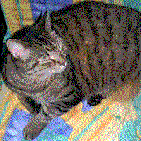
10.4 Steganography 隐写术
Example of steganography in image
Image of a tree with a steganographically hidden image. The hidden image is revealed by removing all but the two least significant bits of each color component and a subsequent normalization.
Image of a cat extracted from the tree image above.
计算机专业英语
1-<number>

Slide 58
10.4 Steganography 隐写术
Example of steganography in text via e-mail
http://www.spammimic.com
计算机专业英语
1-<number>

Slide 59
10.5 Digital forensics 数字取证
Digital forensics (sometimes known as digital forensic science) is a branch of forensic science encompassing the recovery and investigation of material found in digital devices, often in relation to computer crime.
The term digital forensics was originally used as a synonym for computer forensics but has expanded to cover investigation of all devices capable of storing digital data.
数字取证（有时又被认为是数字法医学）是法医学的一个分支，包含了对在数字设备中取得的物质进行还原和调查，这些数字设备一般与计算机犯罪相关。
数字取证这个术语原来是计算机取证的同义词，但已扩展到对所有具备存储数据能力的设备进行调查。
计算机专业英语
1-<number>

Slide 60
10.5 Digital forensics 数字取证
Digital forensics investigations have a variety of applications.
The most common is to support or refute a hypothesis before criminal or civil (as part of the electronic discovery process) courts.
Forensics may also feature in the private sector.
数字取证调查具有各种各样的应用。
最常用的是,在刑事或民事法庭前,支持或驳斥所提出的假设（作为电子发现过程的一种）。
取证在私人部门中也起到重要作用。
计算机专业英语
1-<number>

Slide 61
10.5 Digital forensics 数字取证
The technical aspect of an investigation is divided into several sub-branches, relating to the type of digital devices involved; computer forensics, network forensics, forensic data analysis and mobile device forensics.
The typical forensic process encompasses the seizure, forensic imaging (acquisition) and analysis of digital media and the production of a report into collected evidence.
一个调查的技术现状，按照涉及的数字设备的种类，可分为几个子类：计算机取证、网络取证、取证数据分析和移动设备取证。
典型的取证过程包括捕捉、取证成像（获取）、数字媒体分析和根据收集到的证据形成一个报告。
计算机专业英语
1-<number>

Slide 62
10.5 Digital image forensics 数字图像取证
The modification of images for malicious purposes is now more
common than ever.
Digital Image Forensics is that branch of multimedia security that, together with Digital Watermarking, aims at contrasting and exposing malicious image manipulation.
现在，带有恶意目的的图像修改比以前更加常见。
数字图像取证是多媒体安全的一个分支，与数字水印一起，为了突出和揭露恶意的图像修改。
计算机专业英语
1-<number>

Slide 63
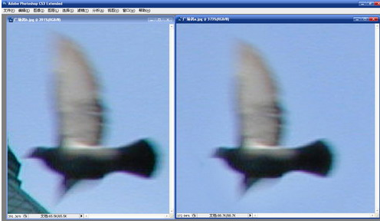
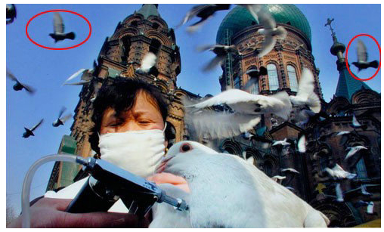
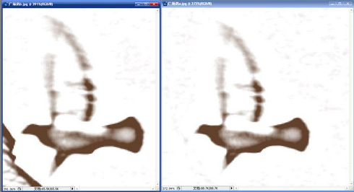
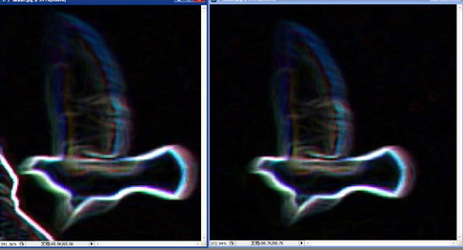
10.5 Digital image forensics 数字图像取证
Copy-Move Forgery Detection
复制-移动篡改检测
首届华赛金奖作品 《广场鸽接种禽流感疫苗》被认定为假照片，华赛组委会决定取消照片获奖资格。
计算机专业英语
1-<number>

Slide 64
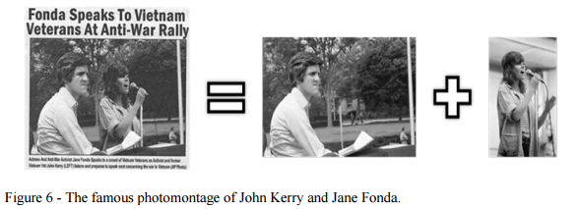
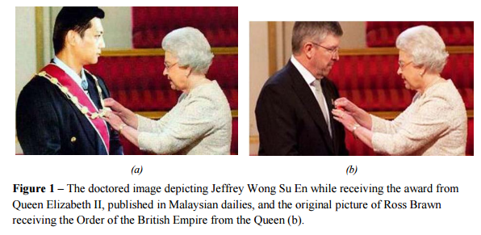
10.5 Digital image forensics 数字图像取证
计算机专业英语
1-<number>

Slide 65
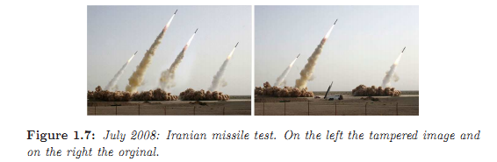
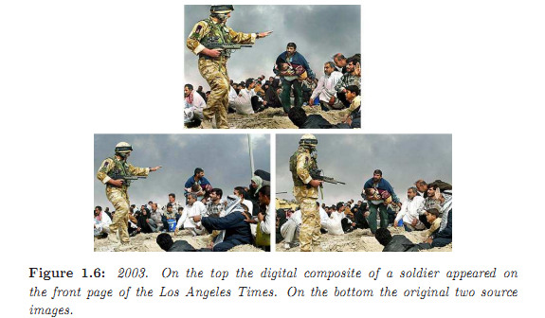
10.5 Digital image forensics 数字图像取证
计算机专业英语
1-<number>

